Slide 1
Paper for octavos Innovation in early sixteenth-century book production. David Shaw
The Bibliographical Society Tuesday 15 December 2020

Slide 2
Medieval paper
Aldine octavos
Octavos after Aldus

Slide 3
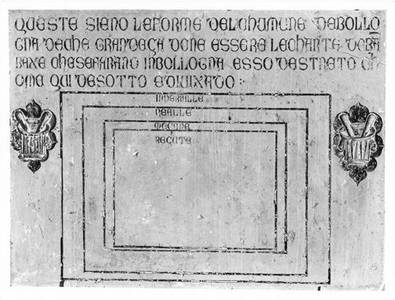
Medieval paper
The Bologna Stone
a late fourteenth-century limestone slab (now in the Museo Civico Medievale of Bologna), which has the approved dimensions of four categories of paper carved into it
Imperialle imperial 68 x 48 cm
Realle royal 42 x 60 cm
Meçane median 35 x 50 cm
Reçute chancery 31·5 x 46 cm
Neil Harris, http://ihl.enssib.fr/en/paper-and-watermarks-as-bibliographical-evidence/the-shape-of-paper
Museo Civico Medievale, Bologna
Notes:
The medieval paper sizes are those used by incunabulists to name the paper sizes of their books.

Slide 4
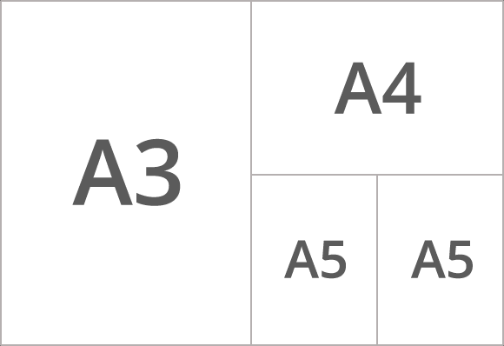
Medieval paper (2)
The shape of the sheet of paper
Divide the height of the sheet by the width :
Ratio of width to height is approximately 1 : 1·41
This is equivalent to 1 : square root of 2 (1·4142135623731)
The same ratio as the modern A0, A1, A2, A3, A4, A5 papers (ISO 216)

Slide 5
Medieval paper (3)
Just like modern A3, A4, A5 paper, when the sheet is folded in two, the height/width ratio remains roughly the same
in folio, quarto, octavo, sextodecimo, etc.,
(but not in 12°, 18°, 24°, etc.)
A chancery sheet (31·5 x 46 cm, ratio 1 : 1·46) gives an octavo page of 15·8 x 11·5 cm (uncut), (ratio 1 : 1·38)

Slide 6
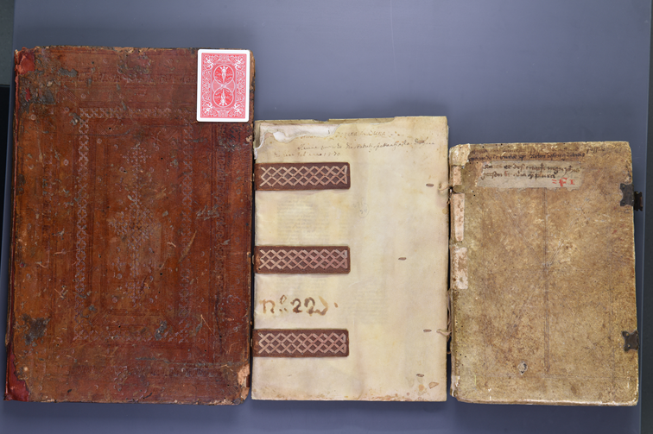
Sheet size is important
Three manuscripts in folio format using three different sizes of paper
Royal folio Median folio Chancery folio
University of Pennsylvania https://schoenberginstitute.org/2017/01/30/the-needham-calculator-1-0-and-the-flavors-of-fifteenth-century-paper/

Slide 7
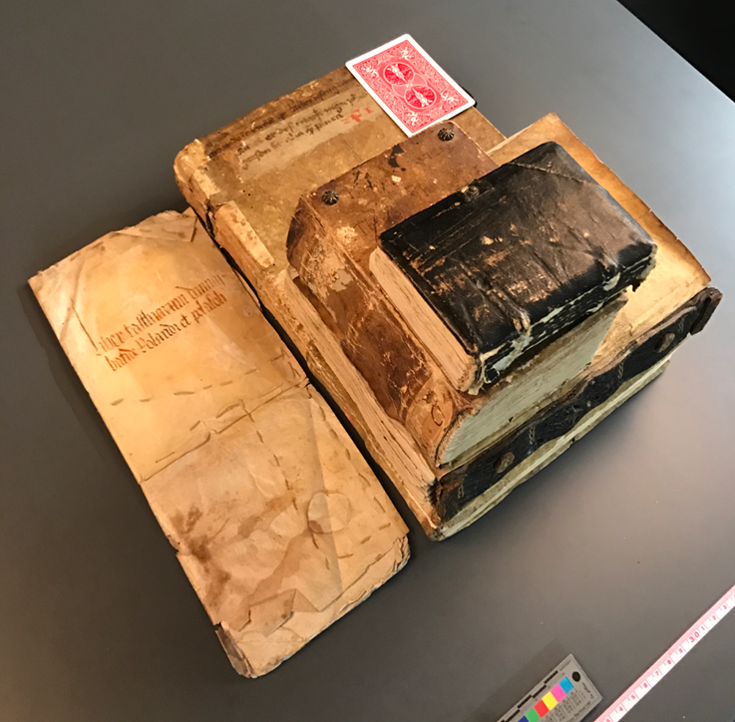
Five manuscripts written on Chancery paper in five formats
16mo
octavo
quarto
agenda quarto folio
University of Pennsylvania
https://schoenberginstitute.org/2017/01/30/the-needham-calculator-1-0-and-the-flavors-of-fifteenth-century-paper/

Slide 8
Paul Needham’s work on early printing paper
As well as Imperial, Royal, Median and Chancery papers, Paul Needham identifies some intermediate sizes used in incunable printing:
Super-royal
Super-median
Super-chancery
These are wider, with a width-to-height ratio of 1 : 1·33 and do not preserve the ratio when folded.
A super-median sheet gives an octavo page of 17 x 13 cm (uncut), ratio 1 : 1·53.

Slide 9
Recording the data for paper sizes
Cataloguers and bibliographers should record page dimensions and should record the sheet size and name, calculated from the format (but they don’t).
The ‘Needham Calculator’ (by Will Noel and colleagues in Philadelphia):
https://schoenberginstitute.org/2017/01/30/the-needham-calculator-1-0-and-the-flavors-of-fifteenth-century-paper/
http://www.needhamcalculator.net/
Notes:
Needham constantly insists that incunable catalogues should record the page and sheet sizes of the books they catalogue.
This is also needed for sixteenth-century books though hardly any catalogues do record these dimensions.

Slide 10
The ‘Needham Calculator’
http://www.needhamcalculator.net/
Produced by Will Noel and colleagues at UPenn, and named after Paul Needham

Slide 11
On into the sixteenth century …

Slide 12
Aldine octavos
1501 : innovations by Aldus Manutius in Venice
a novel publishers’ series
plain-text editions of classical authors (Latin, Greek and Italian)
in octavo format
in italic type
undecorated appearance
new page size, giving tall, slim pages

Slide 13
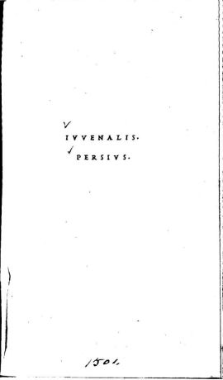
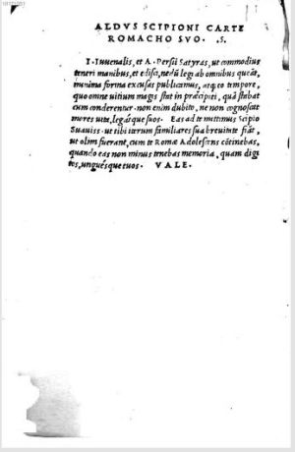
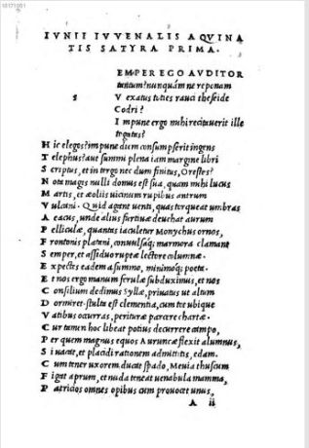
Aldine Juvenal and Persius, 1501
Images from BnF copy, Gallica

Slide 14
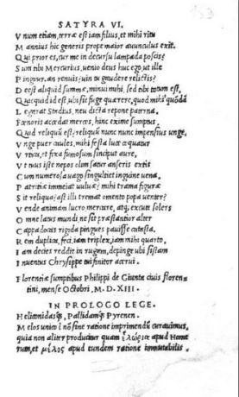
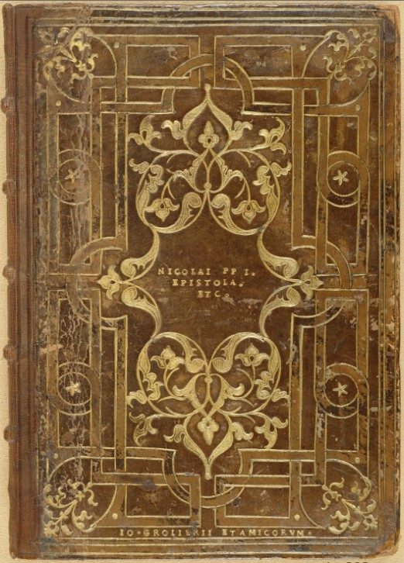
The popularity of the Aldine octavos
The Giunta Juvenal & Persius, Florence 1513
Jean Grolier (and friends)

Slide 15
The paper for the Aldine octavos
The Aldine sheets are squarer than standard, with a width-to-height ratio of 1 : 1·2
When folded for octavo, the uncut page is typically taller and slimmer, with a ratio 1 : 1·67 (1 : 1·63 when trimmed)
Sheet height width ratio
Aldine 17·5 10·5 1·67
Super-chancery 17·0 11·5 1·48
Chancery 15·8 11·5 1·37
Paul Needham calls this new paper size ‘Narrow Median’.
Notes:
The non-standard papers do not preserve the height-to-width ratio when folded.
The Aldine octavos have a noticeably larger ratio because the sheets they are printed from have a smaller ratio – when folded three times the ratio is an inverse.

Slide 16
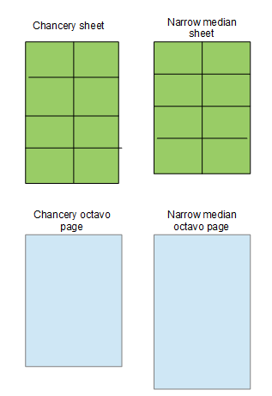
‘Narrow median’ paper
Sheet size : 42 x 35 cm
Ratio : 1 :1·2
Octavo page size : 17·5 x 10·5 cm
Ratio : 1 : 1·67 (or 1 : 1·63 when trimmed by 1 cm)
Notes:
Narrow median is the name Paul Needham has given to the Aldine page size.

Slide 17
The 1501 Aldine Juvenal and the binder
height width ratio
uncut 17·5 10·5 1·67
17 10·5 1·62 (NY, Morgan)
16 9·5 1·68 (British Library)
15·5 9·5 1·63 (NY, PL 1)
15·5 9·5 1·63 (NY, PL 2)
15·5 9·5 1·63 (Oxford, Magdalen)
15 9·3 1·67 (Oxford, Bodleian)
The ratios confirm that all six copies are printed on ‘Narrow Median’ paper.
Notes:
The page dimensions of six copies of the 1501 Aldine Juvenal.

Slide 18
The Needham Calculator
Is designed solely for incunable papers
Does not recognise the narrow-median sheet size

Slide 19
Is Aldus’s Narrow Median paper an innovation?
Are there fifteenth-century octavos printed on narrow median sheets?
Paul Needham confirms that he knows of no incunable narrow-median octavos.
(If only more catalogues recorded page sizes, we could be more sure about this.)
Are there late-15th-century manuscripts written on narrow median paper?

Slide 20
The Aldine counterfeits printed in Lyon

Slide 21
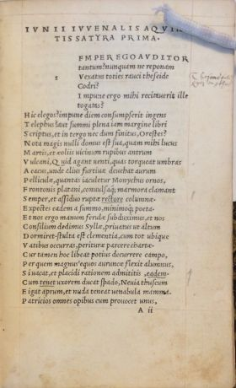
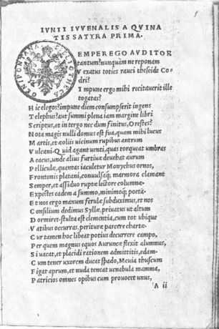
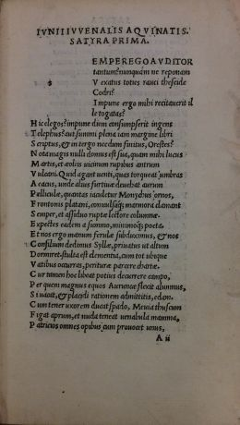
Copying the Aldine octavos
By 1501/1502, printers in Lyons were issuing counterfeit editions of the Aldine octavos
Juvenal: Aldus, 1501 [Lyon, 1501/1502] [Lyon, 1504?] [Lyons, 1506?]

Slide 22
The Lyons Aldine counterfeits : What to copy?
Texts: line-by-line, page-for-page look-alike
Type: a close copy of the Aldine italic type*
Paper: the same tall narrow page size as the Aldines
* David J. Shaw, ‘The Lyons counterfeit of Aldus's italic type: a new chronology’, In: The Italian book 1465–1800: Studies presented to Dennis E. Rhodes on his 70th birthday, edited by Denis V. Reidy, The British Library, London, 1993, pp. 117–133.
Notes:
The Lyons printers wanted to produce close facsimiles of the Asldine octavo editions.
This meant copying the text, using close copies of Aldus’s italic type.
It also meant copying the page sizes Aldus had chosen.

Slide 23
The Lyons Aldine counterfeits
A sample of 27 copies of Lyons Aldine counterfeits, 1501–1505
height-to-width ratios of narrow median paper:
Average : 1 : 1·65 (17.5 x 10.5)
Smallest : 1 : 1·50 (15·2 x 10·1 cm)
Largest : 1 : 1·83 (16·5 x 9·0 cm)
(Chancery or Median paper: 1 : 1·41)

Slide 24
Octavos after Aldus

Slide 25
311 octavos printed in France, 1501–1520, in the British Library collections
42%

Slide 26
French post-incunables (1501–1520)

Slide 27
Octavos printed in Paris by Pierre Vidoue
54 editions printed between 1521 and 1544
9% narrow median sheets
78% narrow super-median sheets

Slide 28
16th-century octavo editions of Juvenal
60 octavo editions of Juvenal
Date range : 1501 to 1599
Average width-to-height ratio : 1 : 1·57 (= narrow median paper)
Range : from 1 : 1·41 / 1 : 1·43 (chancery and super-median paper) up to 1 : 1·75 (narrow median paper)
90% are printed on narrow median or narrow super-median paper)
Source: http://juvenal.referata.com/wiki/Narrow_median_octavos

Slide 29
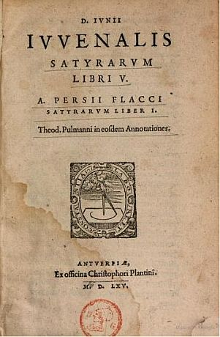
Plantin’s 1565 Juvenal and Persius
Octavo
Page dimensions: 16·5 x 11 cm (Bodleian)
Ratio: 1 : 1·5 (narrow)
Sheet size: 48 x 37 cm
Narrow super-median
Plantin archives: ‘petit bastard’
English equivalent: ‘crown’
http://juvenal.djshaw.co.uk/index.php?title=Juv171

Slide 30
Conclusion
Aldus’s innovation of 1501 was not just the use of italic type and octavo format for classical texts.
Commissioning a new size of paper was quickly recognised by competitors as part of the appeal of his new series of books.
Further questions:
Was narrow median paper used for manuscript production in the late 15th century?
Were there similar developments for other paper sizes in 16th-century: folios, quartos, duodecimos, etc.?
Cataloguers and bibliographers must record page dimensions.

Slide 31
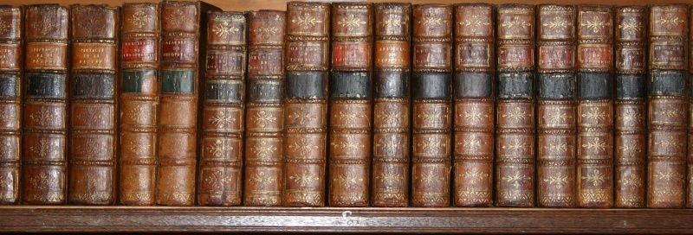
David Shaw
Web site : www.djshaw.uk
Email : david@djshaw.co.uk
Blog: https://www.djshaw.blog/
This file: docs.djshaw.co.uk/BibSoc_2020-12-15.pptx

